Slide 1
How Close?

Slide 2




How Close?
How close is the line passing through points $A$ and $B$ to point $C$?
Gradient, $m=\frac{\left(4−64\right)}{\left(1−−62\right)}=\frac{−60}{63}=\frac{−20}{21}$
$$4=\frac{−20}{21}\left(1\right)+c$$
$$c=\frac{104}{21}$$
Eqn of line: $21y+20x=104$
$$×A\left(−62,64\right)$$
$$×B\left(1,4\right)$$
(not to scale)
$$×C\left(−20,−5\right)$$

Slide 3


How Close?
How close is the line passing through points $A$ and $B$ to point $C$?
Perpendicular gradient, $m=\frac{21}{20}$
$$−5=\frac{21}{20}\left(−20\right)+c$$
$$c=16$$
Eqn of perpendicular line:
$20y−21x=320$
$$21y+20x=104$$
$$×A\left(−62,64\right)$$
$$×B\left(1,4\right)$$
(not to scale)
$$×C\left(−20,−5\right)$$

Slide 4


How Close?
How close is the line passing through points $A$ and $B$ to point $C$?
To find intersection, solve:
$20y−21x=320$ (1)
$21y+20x=104$ (2)
$$\left(−5\frac{15}{29},10\frac{6}{29}\right)$$
$$21y+20x=104$$
$$×A\left(−62,64\right)$$
$20y−21x=320$
$$×B\left(1,4\right)$$
(not to scale)
$$×C\left(−20,−5\right)$$

Slide 5




How Close?
Determine the hypotenuse, $h$, of the triangle:
$h^{2}={\left(−20−−5\frac{15}{29}\right)}^{2}+{\left(−5−10\frac{6}{29}\right)}^{2}$
$$h^{2}={\left(14\frac{14}{29}\right)}^{2}+{\left(15\frac{6}{29}\right)}^{2}$$
$$h^{2}=441$$
$$h=21$$
$$\left(−5\frac{15}{29},10\frac{6}{29}\right)$$
$$h$$
$$\left(−20,−5\right)$$

Slide 6




How Close?
How close is the line passing through points $A$ and $B$ to point $C$?
ALTERNATIVELY, having determined the equation of the line translate it and point $C$ such that $C$ now lies at the origin. That is, translate by vector $\left(\begin{matrix}20 \\ 5\end{matrix}\right)$.
Eqn of line is now: $21\left(y−5\right)+20\left(x−20\right)=104$
or: $21y+20x=609$
Find the $x$ and $y$ intercepts:
$$29$$
$$h$$
$$30\frac{9}{20}$$

Slide 7




How Close?
How close is the line passing through points $A$ and $B$ to point $C$?
Hypotenuse of triangle with sides $29$ and $30\frac{9}{20}$ is:
$$\sqrt{{\left(29\right)}^{2}+{\left(30\frac{9}{20}\right)}^{2}}=42\frac{1}{20}$$
Area of the triangle gives:
$$\frac{1}{2}\left(29\right)\left(30\frac{9}{20}\right)=\frac{1}{2}\left(42\frac{1}{20}\right)h$$
$h=21$
$$29$$
$$h$$
$$30\frac{9}{20}$$

Slide 8

How Close?
How close is the line passing through points $A$ and $B$ to point $C$?
You could even find the intersection of the line and the circle centred on $C$.
Solve the simultaneous equations:
$21y+20x=104$ (1)
${\left(y+5\right)}^{2}+{\left(x+20\right)}^{2}=R^{2}$ (2)
$$21y+20x=104$$
(not to scale)
$$×C\left(−20,−5\right)$$

Slide 9

$21y+20x=104$ (1)
${\left(y+5\right)}^{2}+{\left(x+20\right)}^{2}=R^{2}$ (2)
$y=\frac{−20}{21}x+\frac{104}{21}$ (1)
${\left(\frac{−20}{21}x+\frac{104}{21}+\frac{105}{21}\right)}^{2}+{\left(x+20\right)}^{2}=R^{2}$ (2)
${\left(\frac{−20}{21}x+\frac{209}{21}\right)}^{2}+{\left(x+20\right)}^{2}=R^{2}$
${\left(−20x+209\right)}^{2}+{\left(21x+420\right)}^{2}={{21}^{2}R}^{2}$
$841x^{2}+9280x+220081=441R^{2}$
$841x^{2}+9280x+220081−441R^{2}=0$
For a single root (tangent) the discriminant must equal zero.
So, ${9280}^{2}=4\left(841\right)\left(220081−441R^{2}\right)$
$25600=220081−441R^{2}$
$441R^{2}=194481$
$R=21$
How Close?
(not to scale)
$$×C\left(−20,−5\right)$$

Slide 11
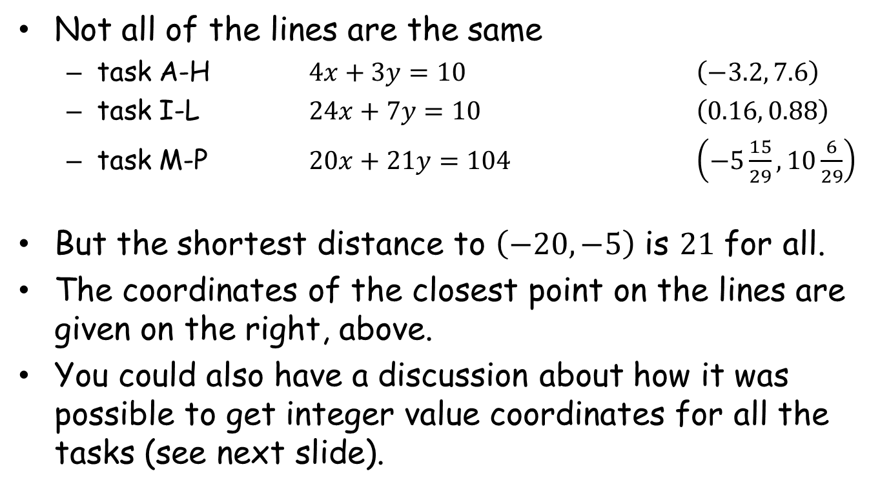
Note to Teacher(1)
Not all of the lines are the same
task A-H $4x+3y=10$ $\left(−3.2, 7.6\right)$
task I-L $24x+7y=10$ $\left(0.16, 0.88\right)$
task M-P $20x+21y=104$ $\left(−5\frac{15}{29}, 10\frac{6}{29}\right)$
But the shortest distance to $\left(−20,−5\right)$ is $21$ for all.
The coordinates of the closest point on the lines are given on the right, above.
You could also have a discussion about how it was possible to get integer value coordinates for all the tasks (see next slide).

Slide 12



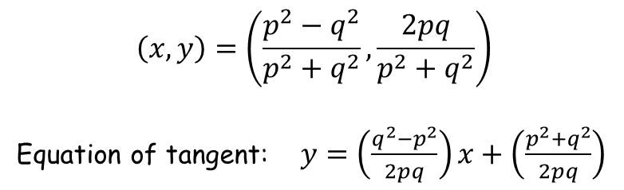
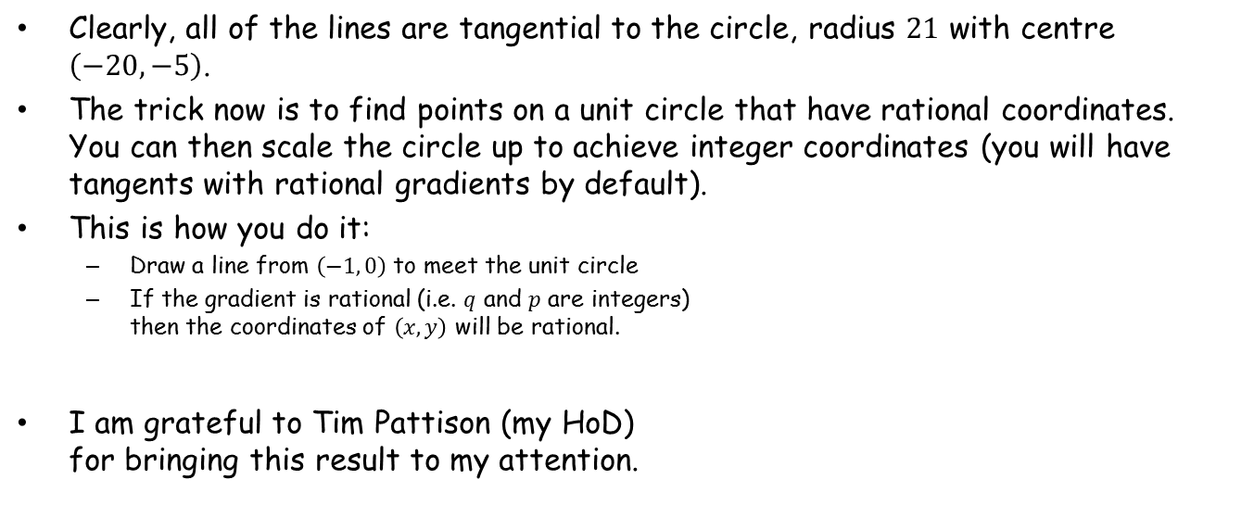






Note to Teacher(2)
Clearly, all of the lines are tangential to the circle, radius $21$ with centre $\left(−20, −5\right)$.
The trick now is to find points on a unit circle that have rational coordinates. You can then scale the circle up to achieve integer coordinates (you will have tangents with rational gradients by default).
This is how you do it:
Draw a line from $\left(−1, 0\right)$ to meet the unit circle
If the gradient is rational (i.e. $q$ and $p$ are integers) then the coordinates of $\left(x, y\right)$ will be rational.
I am grateful to Tim Pattison (my HoD) for bringing this result to my attention.
$$y$$
$$1$$
$$×$$
$$\left(x, y\right)$$
$$q$$
$$p$$
$$−1$$
$$1$$
$$x$$
$$\left(x, y\right)=\left(\frac{p^{2}−q^{2}}{p^{2}+q^{2}}, \frac{2pq}{p^{2}+q^{2}}\right)$$
Equation of tangent: $y=\left(\frac{q^{2}−p^{2}}{2pq}\right)x+\left(\frac{p^{2}+q^{2}}{2pq}\right)$

Slide 13
RESOURCES

Slide 14


SIC_32
How Close?
How close is the line passing through points $A$ and $B$ to point $C$?
$$×A\left(−5,10\right)$$
$$×B\left(1,2\right)$$
(not to scale)
$$×C\left(−20,−5\right)$$
A

Slide 15


SIC_32
How Close?
How close is the line passing through points $A$ and $B$ to point $C$?
$$×A\left(4,−2\right)$$
$$×B\left(10,−10\right)$$
(not to scale)
$$×C\left(−20,−5\right)$$
B

Slide 16


SIC_32
How Close?
How close is the line passing through points $A$ and $B$ to point $C$?
$$×A\left(−8,14\right)$$
$$×B\left(7,−6\right)$$
(not to scale)
$$×C\left(−20,−5\right)$$
C

Slide 17
SIC_32
How Close?
How close is the line passing through points $A$ and $B$ to point $C$?
$$×A\left(−5,10\right)$$
$$×B\left(10,−10\right)$$
(not to scale)
$$×C\left(−20,−5\right)$$
D

Slide 18


SIC_32
How Close?
How close is the line passing through points $A$ and $B$ to point $C$?
$$×A\left(−14,22\right)$$
$$×B\left(−11,18\right)$$
(not to scale)
$$×C\left(−20,−5\right)$$
E

Slide 19

SIC_32
How Close?
How close is the line passing through points $A$ and $B$ to point $C$?
$$×A\left(−2,6\right)$$
$$×B\left(1,2\right)$$
(not to scale)
$$×C\left(−20,−5\right)$$
F

Slide 20

SIC_32
How Close?
How close is the line passing through points $A$ and $B$ to point $C$?
$$×A\left(−8,14\right)$$
$$×B\left(−5,10\right)$$
(not to scale)
$$×C\left(−20,−5\right)$$
G

Slide 21

SIC_32
How Close?
How close is the line passing through points $A$ and $B$ to point $C$?
$$×A\left(−14,22\right)$$
$$×B\left(13,−14\right)$$
(not to scale)
$$×C\left(−20,−5\right)$$
H

Slide 22


SIC_32
How Close?
How close is the line passing through points $A$ and $B$ to point $C$?
$$×A\left(1,−2\right)$$
$$×B\left(15,−50\right)$$
(not to scale)
$$×C\left(−20,−5\right)$$
I

Slide 23


SIC_32
How Close?
How close is the line passing through points $A$ and $B$ to point $C$?
$$×A\left(−6,−22\right)$$
$$×B\left(8,−26\right)$$
(not to scale)
$$×C\left(−20,−5\right)$$
J

Slide 24

SIC_32
How Close?
How close is the line passing through points $A$ and $B$ to point $C$?
$$×A\left(−20,70\right)$$
$$×B\left(15,−50\right)$$
(not to scale)
$$×C\left(−20,−5\right)$$
K

Slide 25

SIC_32
How Close?
How close is the line passing through points $A$ and $B$ to point $C$?
$$×A\left(−13,46\right)$$
$$×B\left(8,−26\right)$$
(not to scale)
$$×C\left(−20,−5\right)$$
L

Slide 26


SIC_32
How Close?
How close is the line passing through points $A$ and $B$ to point $C$?
$$×A\left(1,4\right)$$
$$×B\left(22,−16\right)$$
(not to scale)
$$×C\left(−20,−5\right)$$
M

Slide 27

SIC_32
How Close?
How close is the line passing through points $A$ and $B$ to point $C$?
$$×A\left(−62,64\right)$$
$$×B\left(−20,24\right)$$
(not to scale)
$$×C\left(−20,−5\right)$$
N

Slide 28

SIC_32
How Close?
How close is the line passing through points $A$ and $B$ to point $C$?
$$×A\left(−41,44\right)$$
$$×B\left(1,4\right)$$
(not to scale)
$$×C\left(−20,−5\right)$$
O

Slide 29

SIC_32
How Close?
How close is the line passing through points $A$ and $B$ to point $C$?
$$×A\left(−20,24\right)$$
$$×B\left(22,−16\right)$$
(not to scale)
$$×C\left(−20,−5\right)$$
P

